Slide 1

Capstone Project Phase 1
news website content filtering
Supervisor : Dr. Natali Levi
Students: Ronen Zeyan
Adham Asaad

Slide 2

internet content types
the internet comprise of two main types of content :
Textual such as articles,blog posts, etc…
multimedia such as images,videos,audios, etc…

Slide 3
the problem
websites encompass a wide range of content types that are exposed to user, one part of these contents is interesting and desirable from the user's perspective, the another part is not.
news websites especially display their content without adapting it's content to the desires of a specific user.
some of this contents may make users feel uncomfortable.

Slide 4
Methods and techniques used for filtering
many methods and approaches used for filtering process such as :
black&whilte lists
keyword blocking
category filtering

Slide 5

existing solutions for web filtering
Several solutions exist for content filtering on the internet, which can be categorized into different types:
Browser-based filters : this filters operate at the browser level browser examples : extensions like Ublock Origin
Client-side filters :This solution involves software installed on the user's computer or local servers. such as:
K9,
Open DNS
Dans Guardian
Squid Guard/Squid.
Web mining and data mining: solutions used for automatic detection and analysis of information from the web
other solutions like Internet service provider (ISP) filters,Search engine filtering etc …

Slide 6
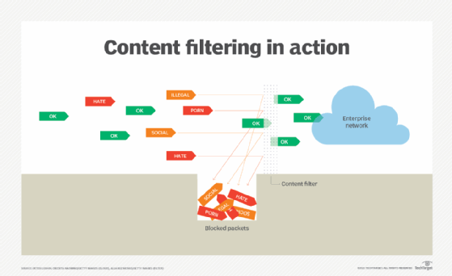
project goal
The goal of our project is to develop a textual content filtering system for news websites. focuses on providing personalized content filtering options to users.

Slide 7
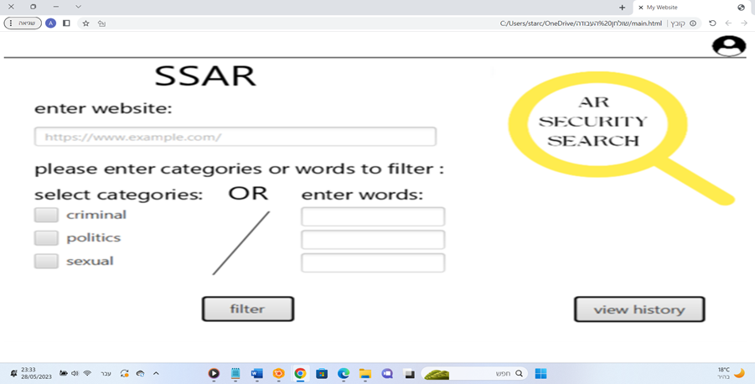
our solution
our solution :
propose a website that allows users to enter a news website URL in english or hebrew language for filtering.
Users will be prompted to specify relevant categories or enter specific words they wish to avoid.
the result a customized website will be displayed to the user, excluding the unwanted content.

Slide 8
implementation process
the implementation process consists of three parts :
receive News Website Link from the User.
Filtering process including three stages.
crawling.
extracting and parsing.
articles classification.
3. build customized copy news website including two stages.
editing HTML code of news website.
display customized news website .

Slide 9
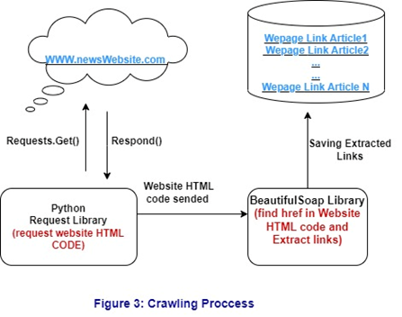
2.Filtering process
crawling stage
in this stage we scan HTML code and extract all the existing links in the news website.
this stage done by two utilized libraries
requests
beautifulSoap
filtering out irrelevant links such as ads,etc…
at the end we obtain all the links of each article in the news website.

Slide 10
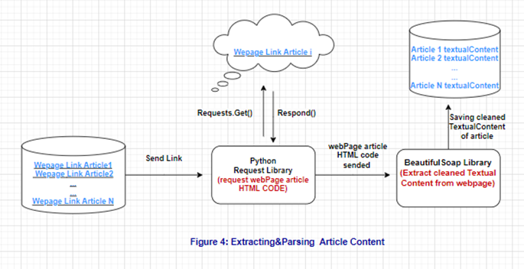
2.Filtering process(cons.)
Extracting and parsing stage
in this stage we extracting from each article link the Textual content of the article.
this stage done by two utilized libraries.
requests
beautifulSoup
Filtering out irrelevant elements ,extract clean textual Content.
at the end we obtain a relevant textual content of each article in the news website.

Slide 11
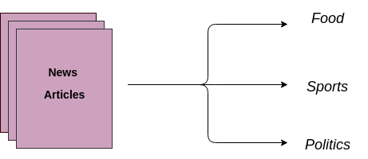
2.Filtering process(cons.)
Articles classification stage
In this stage, we have decided for each article whether to display it or not.
we classify all the articles in the news website for desired and undesired.
In our project, users have two options for filtering.
categories based filtering
free words based filtering
we utilize two algorithms for filtering, one for categories and another for free words.
Desired
Undesired

Slide 12
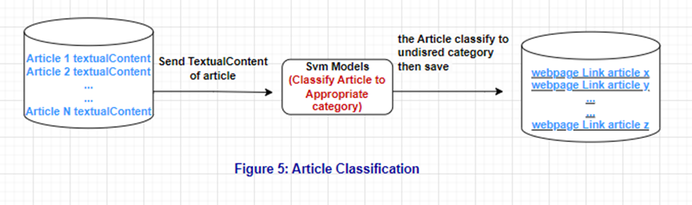
a. categories based filtering
In this option, users can select categories they don't want to see articles related to, such as politics, murder, sexuality, etc.
classify all the articles on the website into their appropriate category from a predefined set of categories.
We chose to use an SVM (Support Vector Machine) model with OVA(ONE VS ALL) technique for classification mission.
In this approach, we train N binary SVM classifiers, one for each category. The class with the highest confidence is then predicted.

Slide 13
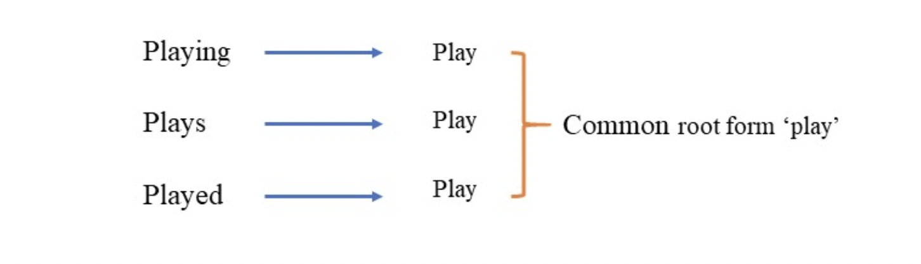
b. free words based filtering
in this option user can enter related words for contents he want to filter.
the chosen approach is to search for the appearance of the received words in the articles,if its appear then we filtering it.
before we apply this approach, we convert the related words and the articles to its root mode.
by The NLTK.STEM library we convert the related words and the article to root mode.
NLTK.STEM

Slide 14
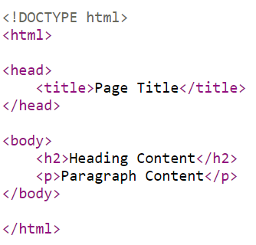
3.build customzied copy of the news website process
Edit HTML code of the website stage
In this stage we manipulate the html code of the news website.
The Beautiful Soup library facilitates this process by parsing the HTML code, allowing us to manipulate its elements.
Delete unwanted HTML code sections containing links, based on information from the classification stage.
Locating and eliminating the targeted elements.
the result Modified HTML code without the unwanted articles.

Slide 15
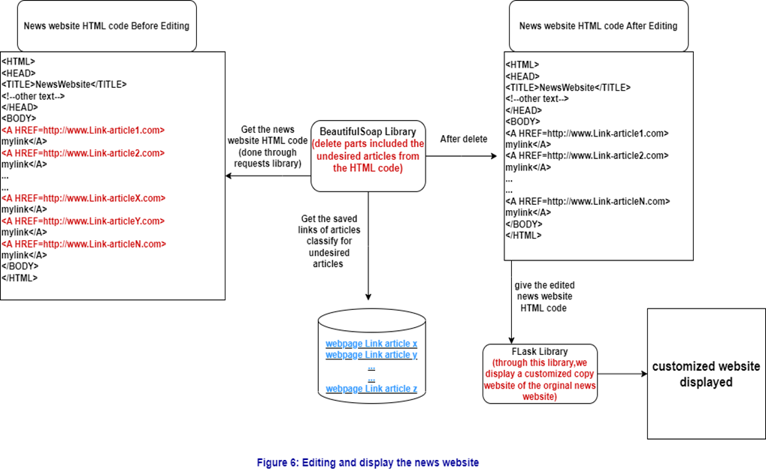
3.build customzied copy of the news website process(cons).
display the evaluated HTML code on our server stage
in this stage we will display the news website we manipulated in previous stage.
The Flask library facilitates this process.

Slide 16
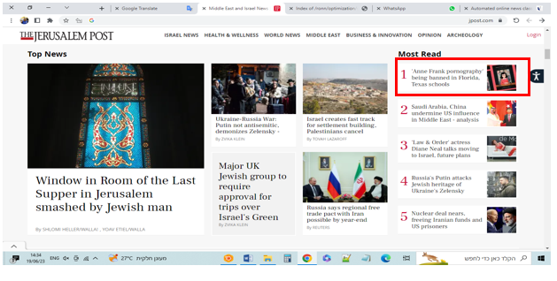
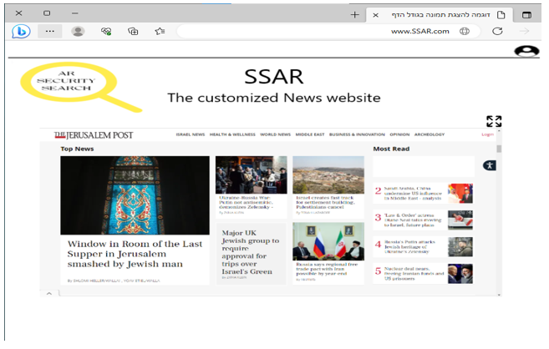
Final Product Showcase
news website before filtering.
news website after filtering displayed in our website.

Slide 17
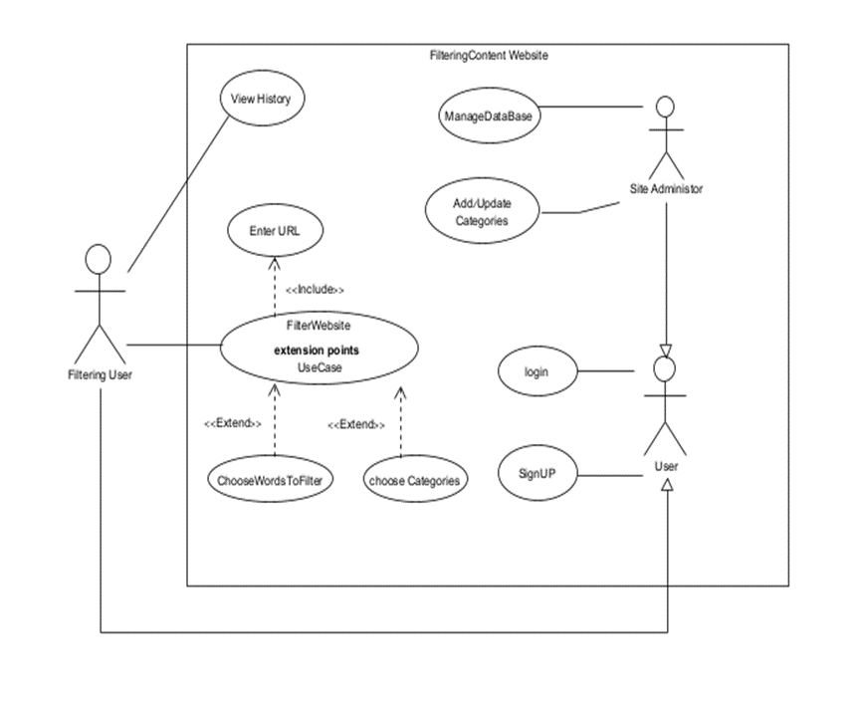
USE CASE Diagram

Slide 18
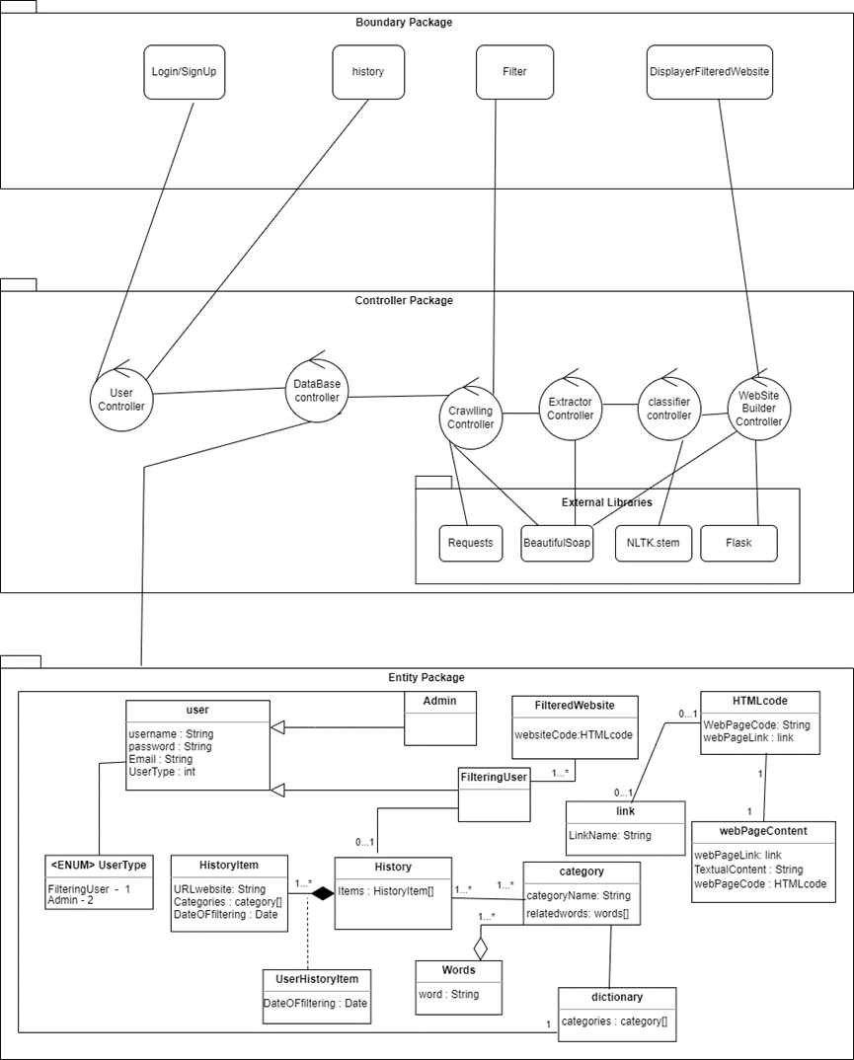
Class Diagram

Slide 19
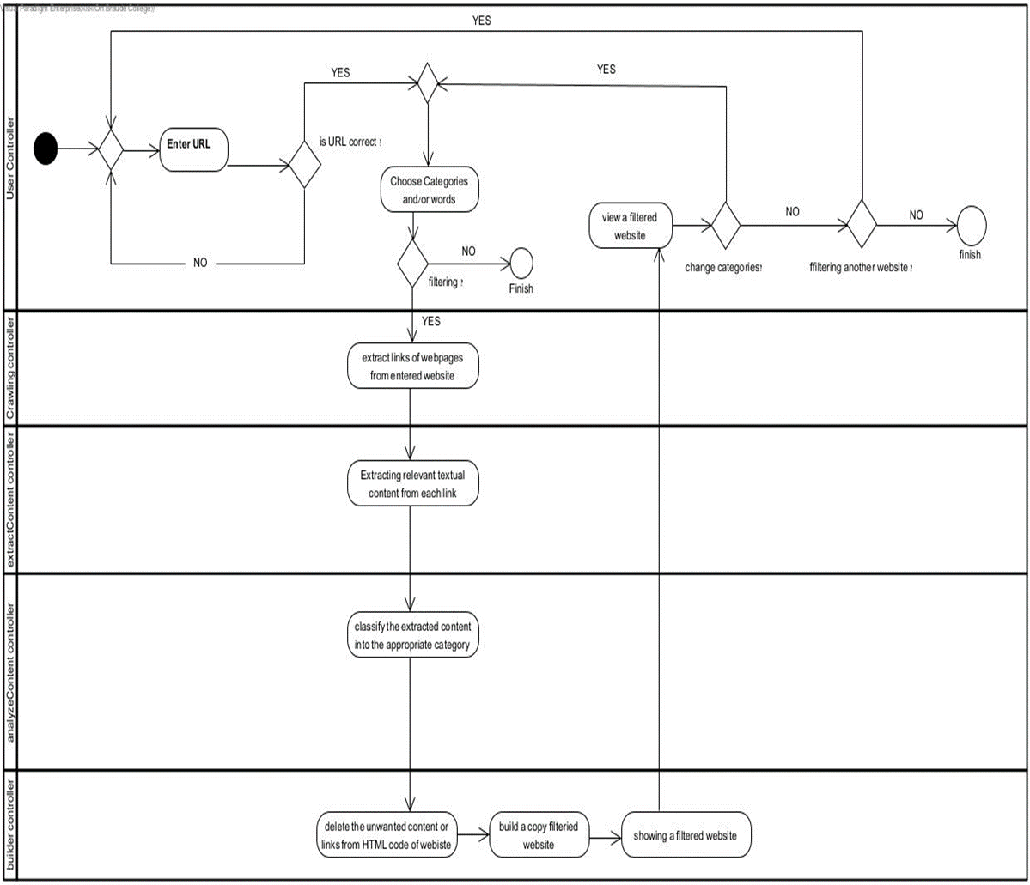
Activity Diagram

Slide 20


testing plan
To ensure that our product is functioning properly and meeting our expectations, we will testing it using the following methods:
1. Have the system evaluated by 8 users 4 of them using the filtering with categories and the others using the filtering with free words.
each user will be assigned a different structured news website in a distinct language.
2. Implement tests.

Slide 21

The Challenges
User Interface and Data Collection
Link Extraction
Link Classification
Unwanted Link Filtering
Data Storage and Retrieval

Slide 22

problems and constraints
Large volume of data
Runtime and performance considerations
provide a suitable dataset for training the model

Slide 23
Thank you

